Slide 1
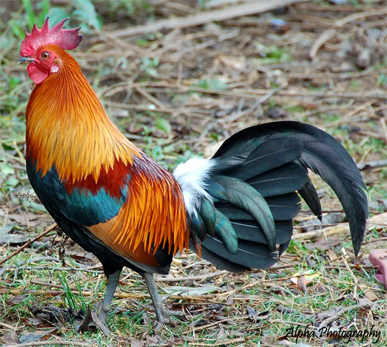
Differential Analysis Project
BS32010 - Applied Bioinformatics

Slide 2
Gallus Gallus
Red Junglefowl
“The Red Junglefowl (Gallus gallus) is a tropical member of the Pheasant family. It is thought to be ancestral to the domestic chicken, with some hybridization with the Grey Junglefowl. The Red Junglefowl was first domesticated at least several thousand years ago in Asia, and the domestic form is kept globally as a very productive food source of both meat and eggs. Some breeds have been specifically developed to produce these.”
www.twerth.com

Slide 3
Part 1
RMA Normalisation
DESeq2

Slide 4
RMA Normalisation
if(! require(affy)){
source("http://bioconductor.org/biocLite.R")
biocLite("affy")
require(affy)}
library(GEOquery)
library(arrayQualityMetrics)
library(chicken.db)
library(chickenprobe)
library(annotate)
library(genefilter)
library(cluster)
library(limma)
library(affyPLM)
workingDir="/homes/rnmaconeghy/BS32010/Project/
GCOS_Cel”
filenames <- c("ROS1-_9.CEL", "ROS1+_10.CEL",
"ROS2-_11.CEL", "ROS2+_12.CEL",
"ROS3-_13.CEL", "ROS3+_14.CEL",
"ROS4-_15.CEL", "ROS4+_16.CEL")
samplenames <- c("ROS1-_9.CEL", "ROS1+_10.CEL",
"ROS2-_11.CEL", "ROS2+_12.CEL", "ROS3-_13.CEL",
"ROS3+_14.CEL", "ROS4-_15.CEL", "ROS4+_16.CEL")
targets <- c("minus", "plus", "minus", "plus", "minus",
"plus", "minus", "plus")

Slide 5
RMA Normalisation
phenodata<-as.data.frame(cbind
(filenames,samplenames,targets))
celRAW <- ReadAffy(celfile.path=workingDir, phenoData=phenodata)
.plotDensity <- function(exps, filename)
{pdf(filename)
d <- apply(exps,2,
function(x){
density(x)})
xmax <- max(sapply(d,function(x)max(x$x)))
xmin <- min(sapply(d,function(x)min(x$x)))
ymax <- max(sapply(d,function(x)max(x$y)))
plot(0,pch='',ylab='',xlab='',
xlim=c(xmin,round(xmax+1)),ylim=c(0,ymax))
lapply(1:length(d),function(x) lines(d[[x]],col=x))
dev.off()}
.doPLM <- function(celRAW)
{pdf("celRAWqc.pdf")
celRAWqc <- fitPLM(celRAW)
image(celRAWqc, which=1, add.legend=TRUE)
image(celRAWqc, which=4, add.legend=TRUE)
RLE(celRAWqc, main="RLE")
NUSE(celRAWqc, main="NUSE")
dev.off()}
.doCluster <- function(celRMA)
{eset <- exprs(celRMA)
distance <- dist(t(eset), method="maximum")
clusters <- hclust(distance)
plot(clusters)}
.doFilter <- function(celRMA)
{ celfiles.filtered <- nsFilter(celRMA,
require.entrez=FALSE,
remove.dupEntrez=FALSE)}
.doDE <- function(eset)
{samples <- eset$targets
samples <- as.factor(samples)
design <- model.matrix(~0 + samples)
colnames(design) <- c("plus", "minus")
fit <- lmFit(exprs(eset), design)
ebFit <- eBayes(fit)
ttab <- topTable(ebFit, number=10000)
annotation <- as.data.frame(select(chicken.db,
rownames(ttab),
c("ENSEMBL", "SYMBOL")))
colnames(annotation) <- c("probeId", "ensemblId", "geneSymbol")
results <- merge(annotation, ttab,by.x="probeId",by.y="row.names")
head(results)
write.table(results, "results.txt", sep="\t", quote=FALSE)
return(results)}
if(!exists("celResults"))
{eset <- exprs(celRAW)
celGCRMA <- gcrma(celRAW)
celRMA <- rma(celRAW)
.plotDensity(log2(exprs(celRAW)),"densityRAW.pdf")
.plotDensity(log2(exprs(celRMA)),"densityRMA.pdf")
celFilt <- .doFilter(celRMA)
celResults <- .doDE(celFilt$eset)}

Slide 6
DESeq2
require(DESeq2)
require(biomaRt)
dat<-read.delim("/usr/local/share/BS32010/expression/data/RNAseqCounts.txt",
sep="\t",skip=1,head=T,row.names=1)
roscdata <-dat[14:20]
colnames(roscdata)<-c("ROS1_minus",
"ROS1_plus","ROS2_minus","ROS2_plus","ROS3_minus",
"ROS3_plus","ROS4_minus")
nonZeroCounts<-roscdata[rowSums(roscdata)>0,]
treatments <- c("minus","plus","minus",
"plus","minus","plus","minus")
dds<- DESeqDataSetFromMatrix(as.matrix(nonZeroCounts),
as.data.frame(treatments),
design=~treatments)
dds$treatments <-relevel(dds$treatments, "minus")
dds<-DESeq(dds)
DEresults<- results(dds)
mart <- useMart("ensembl")
mart<-useDataset("ggallus_gene_ensembl",mart)
annot <- {getBM(attributes=c("ensembl_gene_id",
"external_gene_id","affy_chicken"),
filter="ensembl_gene_id",
values=rownames(DEresults),
mart=mart)}
annotResults <- merge(annot,DEresults,
by.x="ensembl_gene_id",by.y="row.names")

Slide 7
DESeq2

Slide 8
Results
From my celResults from the RMA normalization, I have identified these 3 genes to be the most significantly differentially expressed:
PTP4A2 – located on chromosome 23
PSMD6 - located on chromosome 12
DDX1 – located on chromosome 3

Slide 9
Results
The function of our identified genes
Acts as an ATP-dependent RNA helicase
They are able to unwind both RNA-RNA and RNA-DNA duplexes
Possesses 5’ single-stranded RNA overhung nuclease activity
Acts as a positive regulator of transcription
May be involved in 3’-end cleavage and polydenylation of pre-mRNAs
Binds DNA and RNA
www.uniprot.org

Slide 10
Part 2 and 3
NCBI database
NCBI Blast
Ensembl
Comparisons

Slide 11
NCBI and Blast
Take identified significantly differentially expressed genes and enter gene into NCBI database
Run the .fasta file of the gene in Blast
Identify homologues
Find closest linked homologue
Search both homologue and chicken genomes and compare

Slide 12
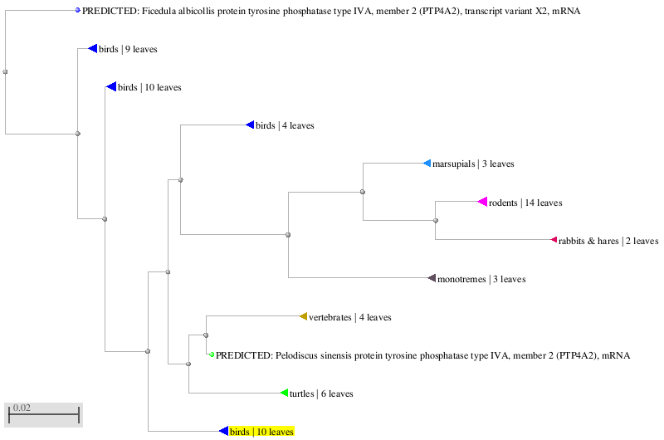
PTP4A2 Blast

Slide 13
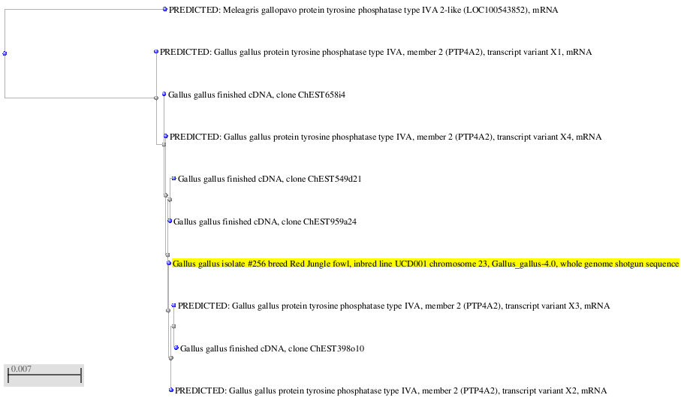
PTP4A2 Blast

Slide 14
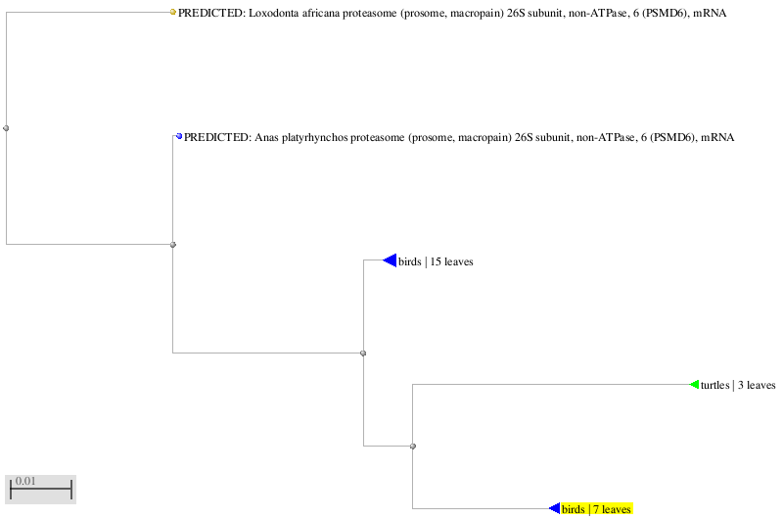
PSMD6 Blast

Slide 15
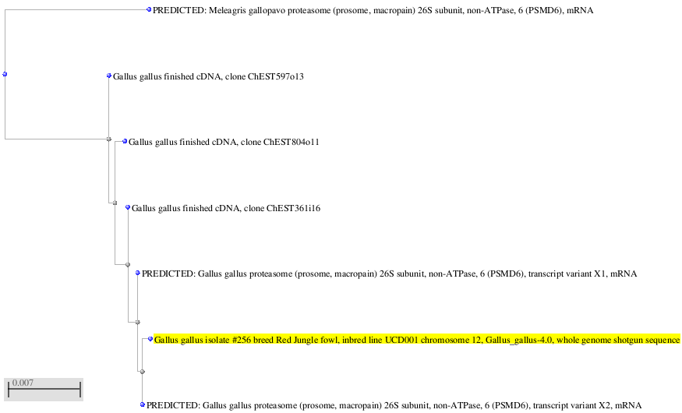
PSMD6 Blast

Slide 16
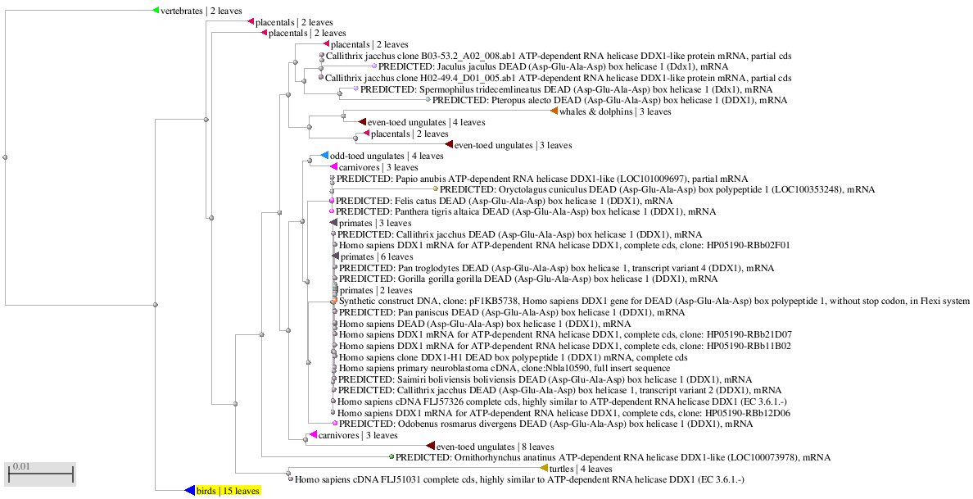
DDX1 Blast

Slide 17
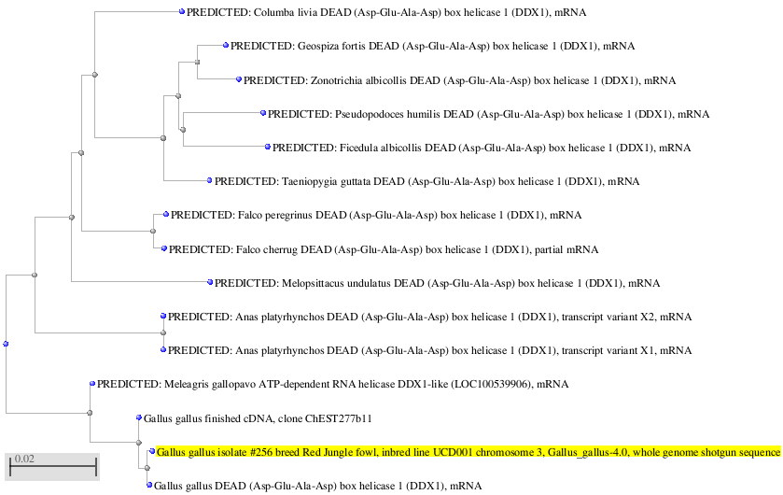
DDX1 Blast

Slide 18
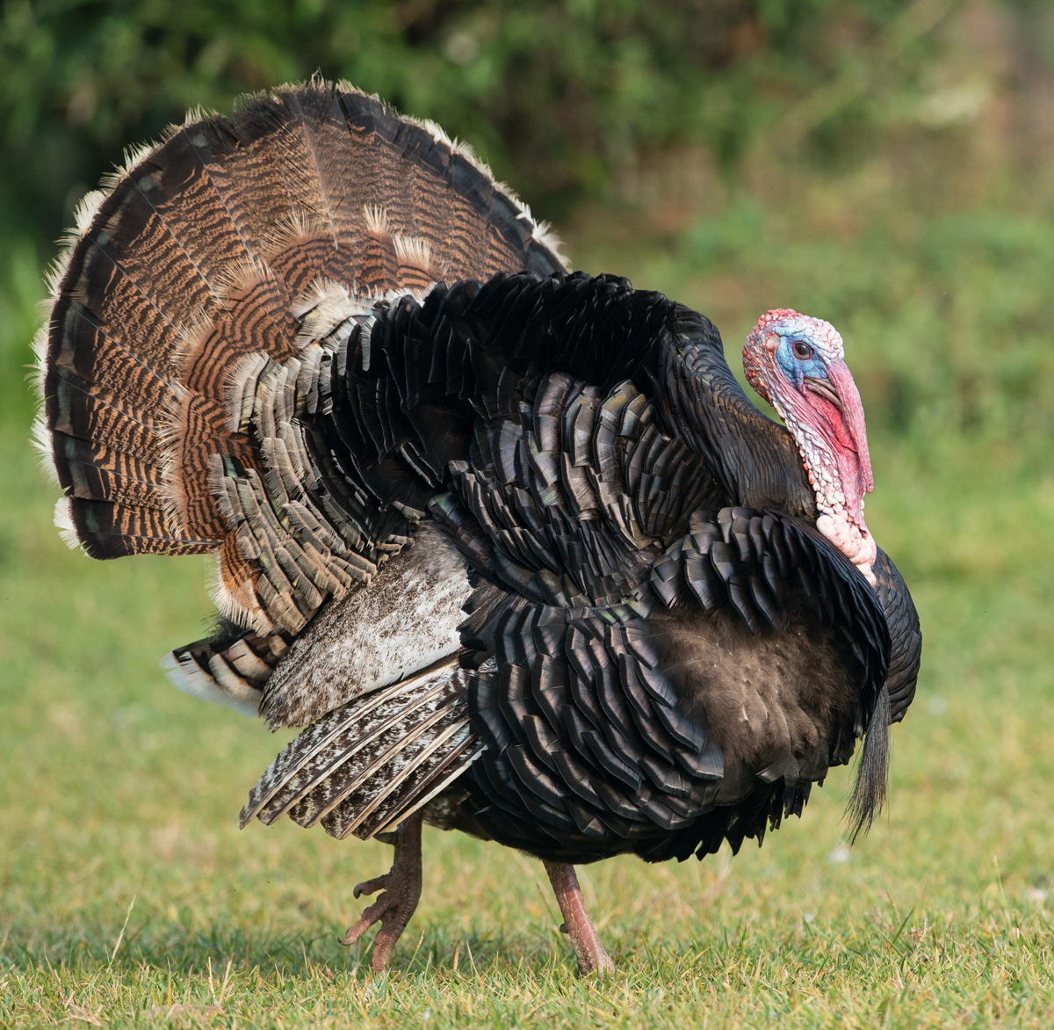
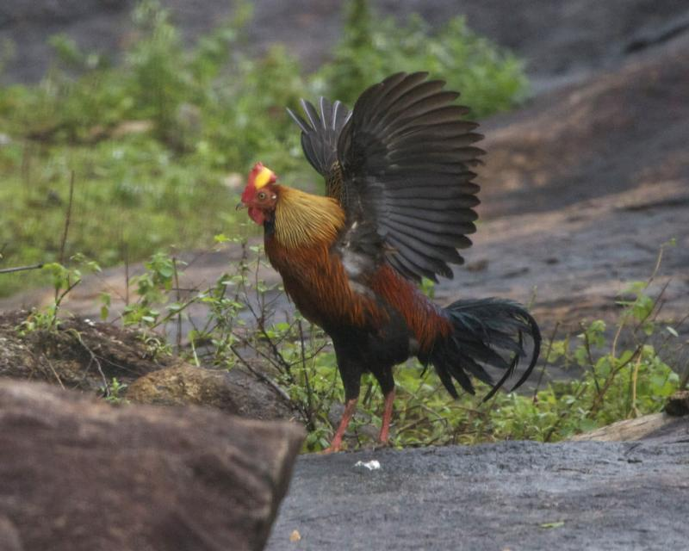
Turkey vs Chicken

Slide 19
Chicken v Turkey Genome for PTP4A2

Slide 20
Chicken v Turkey Genome for PSMD6

Slide 21
Chicken v Turkey Genome for DDX1

Slide 22
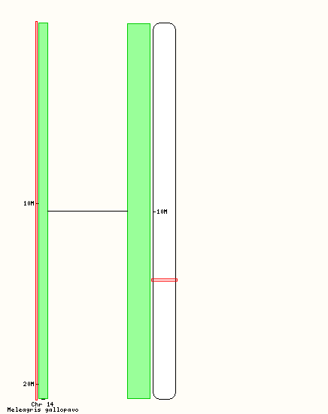
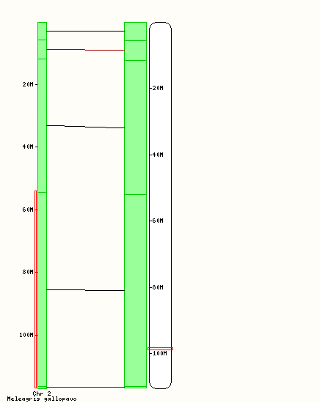
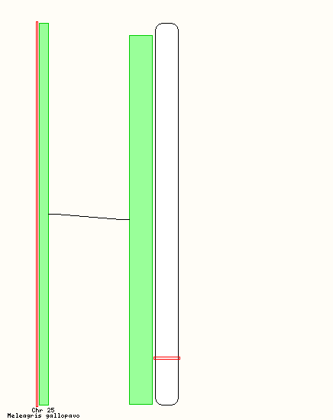
Synteny between Chicken and Turkey
DDX1
PSMD6
PTP4A2

Slide 23
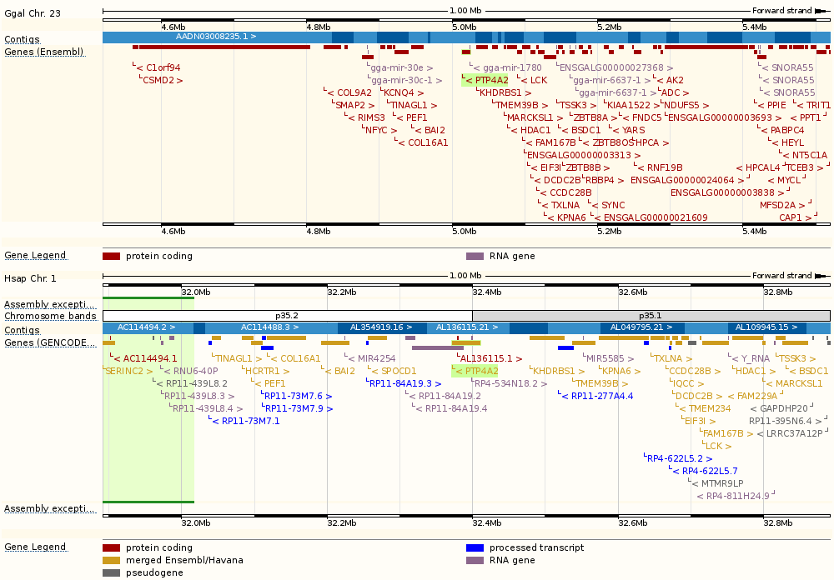
PTP4A2

Slide 24
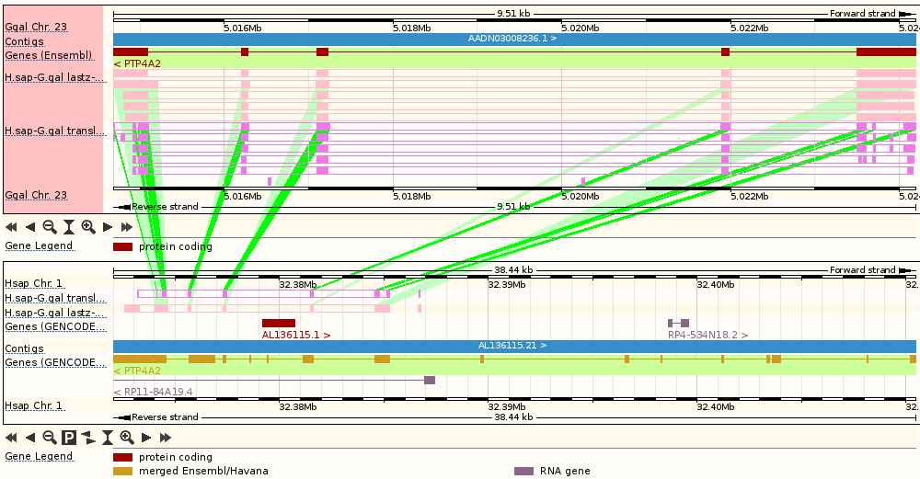
PTP4A2

Slide 25
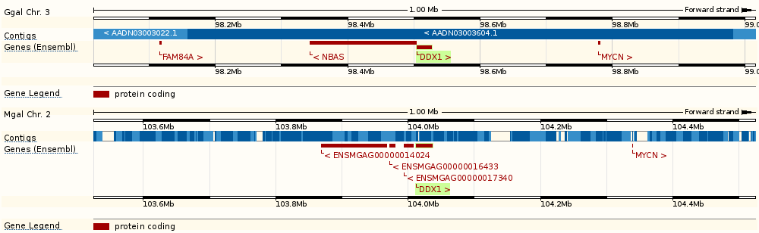
PSMD6

Slide 26
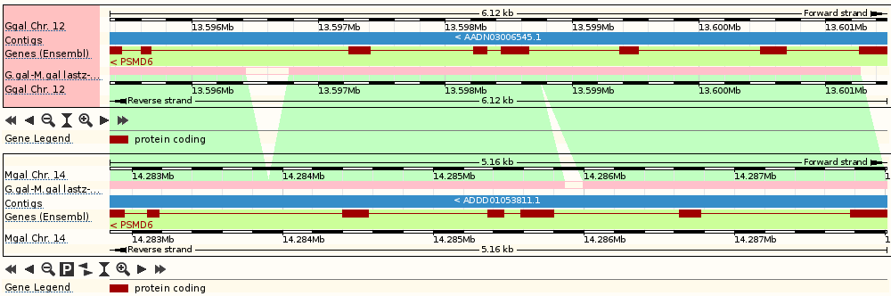
PSMD6

Slide 27
DDX1 Synteny

Slide 28
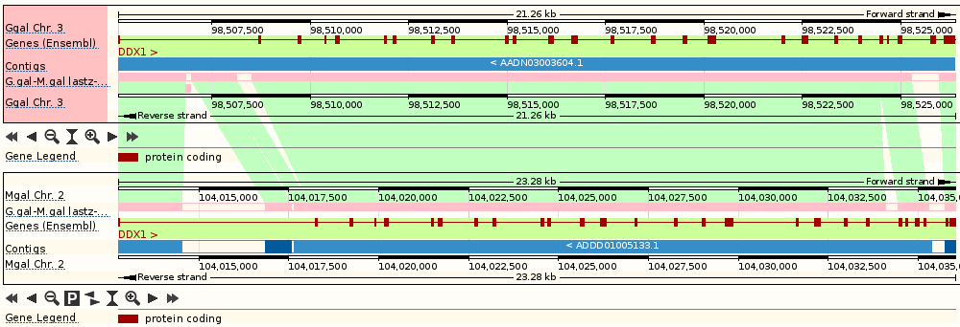
DDX1 Synteny

Slide 29
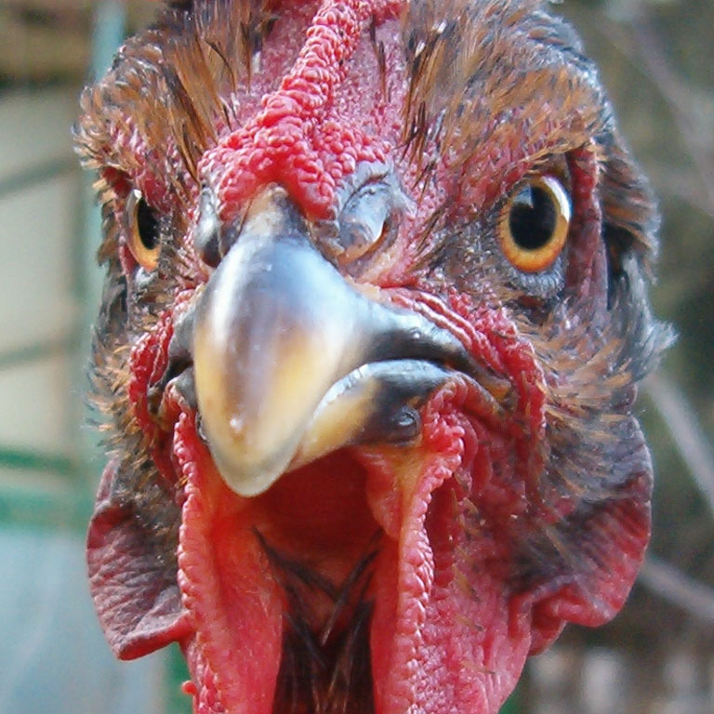
The end.

